Slide 1
Programming with Python
Basic Concepts 2

Slide 2

Lesson Objectives
List
Tuples
Sets
Dictionaries
Working with files

Slide 3
List
Section 1

Slide 4

List
The important characteristics
Lists are ordered.
Lists can contain any arbitrary objects.
List elements can be accessed by index.
Lists can be nested to arbitrary depth.
Lists are mutable.
Lists are dynamic.

Slide 5
List
Lists are ordered
A list is not merely a collection of objects.
It is an ordered collection of objects.
The order in which you specify the elements when you define a list is an innate characteristic of that list and is maintained for that list’s lifetime.
a = ['a', 'b', 'c', 'd']
b = ['b', 'a', 'd', 'c']
a == b

Slide 6
List
Lists Can Contain Arbitrary Objects
A list can contain any assortment of objects
Lists can even contain complex objects, like functions, classes, and modules
a = [21.42, 'foobar', 3, 4, 'bark', False, 3.14159]
def foo():
pass
import numpy as np
list_a = [1, int, foo, np]

Slide 7
List
List Elements Can Be Accessed by Index
a = ['foo', 'bar', 'baz', 'qux', 'quux', 'corge']
print(a[0])
print(a[-1])

Slide 8
List
List Elements Can Be Accessed by Index
Slicing also works
a = ['foo', 'bar', 'baz', 'qux', 'quux', 'corge']
print(a[0:2])
print(a[-3:-1])

Slide 9
List
List Elements Can Be Accessed by Index
Other features of string slicing work analogously for list slicing as well
print(a[:4], a[0:4])
print(a[2:], a[2:len(a)])
a[:4] + a[4:]
a[:4] + a[4:] == a

Slide 10
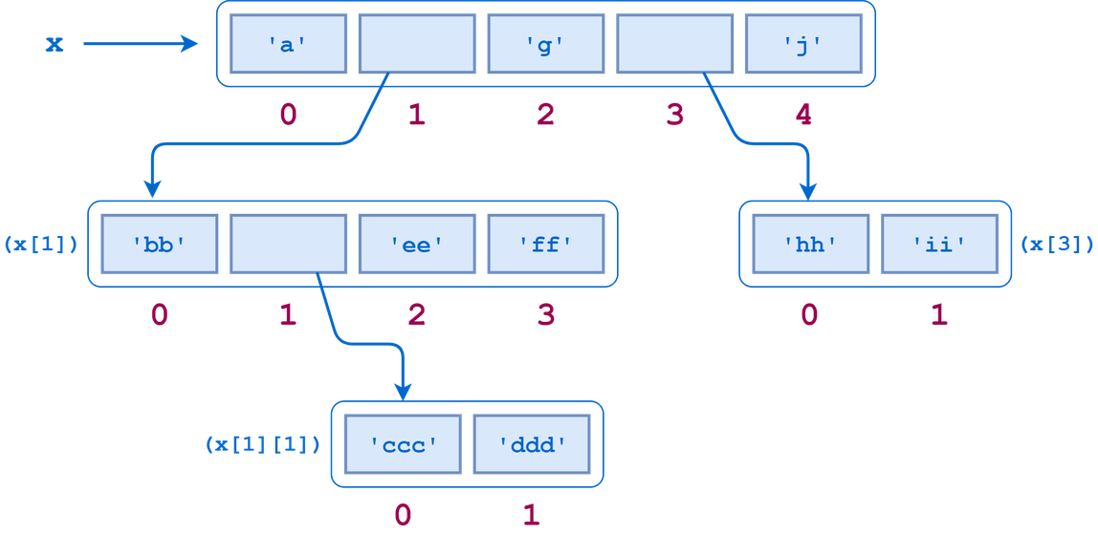
List
Lists Can Be Nested
A list can contain sublists

Slide 11
List
Lists Are Mutable
Modifying a Single List Value
Modifying Multiple List Values
a = ['foo', 'bar', 'baz', 'qux', 'quux', 'corge']
a[2] = 'x'
a[-2] = 10
a = ['foo', 'bar', 'baz', 'qux', 'quux', 'corge']
print(a[1:4])
a[1:4] = [0.5, 0.1, 55, 33, 231, 1213]
print(a)

Slide 12
List
Methods That Modify a List
a.append(<obj>)
a.extend(<iterable>)
a.insert(<index>, <obj>)
a.remove(<obj>)
a.pop(index=-1)

Slide 13
Tuples
Section 2

Slide 14
Tuples
Defining and Using Tuples
Tuples are defined by enclosing the elements in parentheses (()) instead of square brackets ([]).
Tuples are immutable.
te = ()
t = ('fpt', 1, 4)

Slide 15
Tuples
Why use a tuple instead of a list?
Program execution is faster when manipulating a tuple than it is for the equivalent list
Sometimes you don’t want data to be modified
te = ()
t = ('fpt', 1, 4)

Slide 16
Set
Section 3

Slide 17
Set
A set is a collection which is unordered and unindexed
Note: the set list is unordered, meaning: the items will appear in a random order.
thisset = {"banana", "apple", "cherry", 'kiwi', 'banana', 'apple'}
print(thisset)

Slide 18
Set
You cannot access items in a set by referring to an index or a key
using a for loop
using the in keyword
thisset = {"banana", "apple", "cherry", 'kiwi', 'banana', 'apple'}
for x in thisset:
print(x)
thisset = {"banana", "apple", "cherry", 'kiwi', 'banana', 'apple'}
print("kiwi" in thisset)

Slide 19
Dictionary
Built-in Set Methods
Add Items
Update Items
thisset = {"banana", "apple", "cherry", 'kiwi', 'banana', 'apple'}
thisset.add("orange")
print(thisset)
thisset = {"banana", "apple", "cherry", 'kiwi', 'banana', 'apple'}
thisset.update(["orange", "mango", "grapes", "kiwi"]) print(thisset)

Slide 20
Dictionary
Built-in Set Methods
Remove Item with .remove()
Update Items with .discard()
.remove() ? .discard()
thisset = {"banana", "apple", "cherry", 'kiwi', 'banana', 'apple'}
thisset.remove("banana")
print(thisset)
thisset = {"banana", "apple", "cherry", 'kiwi', 'banana', 'apple'} thisset.discard("banana") print(thisset)
Notes:
Note: If the item to remove does not exist, discard() will NOT raise an error.

Slide 21
Dictionary
Section 4

Slide 22
Dictionary
Dictionaries and lists share the following characteristics
Both are mutable.
Both are dynamic. They can grow and shrink as needed.
Both can be nested. A list can contain another list. A dictionary can contain another dictionary. A dictionary can also contain a list, and vice versa.

Slide 23
Dictionary
Dictionaries differ from lists primarily in how elements are accessed:
List elements are accessed by their position in the list, via indexing.
Dictionary elements are accessed via keys.

Slide 24
Dictionary
Defining a Dictionary
d = {
<key>: <value>,
<key>: <value>,
.
.
.
<key>: <value>
}
d = dict([
(<key>, <value>),
(<key>, <value),
.
.
.
(<key>, <value>)
])

Slide 25
Dictionary
Accessing Dictionary Values
Access by key
Modify by key
thisdict[<key>]
thisdict[<key>] = <new value>

Slide 26
Dictionary
Building a Dictionary Incrementally
person = {}
print(type(person))
# <class 'dict'>
person['fname'] = 'Joe'
person['lname'] = 'Fonebone'
person['age'] = 51
person['spouse'] = 'Edna'
person['children'] = ['Ralph', 'Betty', 'Joey']
person['pets'] = {'dog': 'Fido', 'cat': 'Sox'}

Slide 27
Dictionary
Operators and Built-in Functions
thisdict = {
"brand": "Ford",
"model": "Mustang",
"year": 1964
}
print('brand' in thisdict)
print('uuu' in thisdict)
print('uuu' not in thisdict)

Slide 28
Dictionary
Built-in Dictionary Methods
d.clear()
d.get(<key>[, <default>])
d.items()
d.keys()
d.values()
d.pop(<key>[, <default>])
d.popitem()
d.update(<obj>)

Slide 29

Thank you

